Slide 1

Numerical Differentiation
不正经讲师：理科宅Hunt

Slide 2

General derivation using Lagrange interpolation
Suppose $n+1$ data points are given $\left(x_{0},f\left(x_{0}\right)\right),\left(x_{1},f\left(x_{1}\right)\right), …,(x_{n},f\left(x_{n}\right))$. By Lagrange interpolation, we have
$$f\left(x\right)=\sum_{i=0}^{n}{f\left(x_{i}\right)L_{i}(x)}+\frac{f^{\left(n+1\right)}\left(ξ(x)\right)}{\left(n+1\right)!}\prod_{i=0}^{n}{\left(x−x_{i}\right)}$$
Where $L_{i}(x)=\prod_{k≠i}^{n}{\frac{x−x_{i}}{x_{k}−x_{i}}}$ .
Therefore, the 1-st order derivative is given by
$$f^{′}\left(x\right)=\sum_{i=0}^{n}{f\left(x_{i}\right){L^{′}}_{i}(x)}+\frac{f^{\left(n+2\right)}\left(ξ(x)\right)ξ′(x)}{\left(n+1\right)!}\prod_{i=0}^{n}{\left(x−x_{i}\right)}+\frac{f^{\left(n+1\right)}\left(ξ(x)\right)}{\left(n+1\right)!}\frac{d}{dx}\left[\prod_{i=0}^{n}{\left(x−x_{i}\right)}\right]$$
Let $x=x_{j}$, we have
$$f^{′}\left(x_{j}\right)=\sum_{i=0}^{n}{f\left(x_{i}\right){L^{′}}_{i}(x_{j})}+\frac{f^{\left(n+1\right)}\left(ξ(x_{j})\right)}{\left(n+1\right)!}\frac{d}{dx}{\left[\prod_{i=0}^{n}{\left(x−x_{i}\right)}\right]}_{x=x_{j}}$$

Slide 3
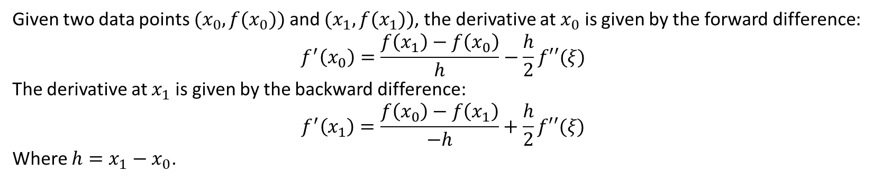
Forward/Backward difference
Given two data points $(x_{0},f(x_{0}))$ and $(x_{1},f(x_{1}))$, the derivative at $x_{0}$ is given by the forward difference:
$$f^{′}\left(x_{0}\right)=\frac{f\left(x_{1}\right)−f\left(x_{0}\right)}{h}−\frac{h}{2}f′′(ξ)$$
The derivative at $x_{1}$ is given by the backward difference:
$$f^{′}\left(x_{1}\right)=\frac{f\left(x_{0}\right)−f\left(x_{1}\right)}{−h}+\frac{h}{2}f′′(ξ)$$
Where $h=x_{1}−x_{0}$.

Slide 4
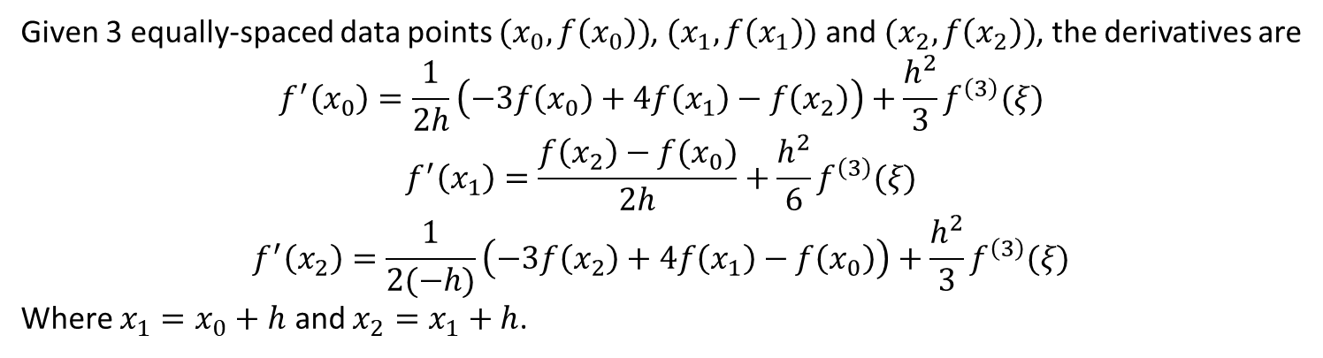
Three-point formula
Given 3 equally-spaced data points $(x_{0},f\left(x_{0}\right))$, $(x_{1},f\left(x_{1}\right))$ and $(x_{2},f\left(x_{2}\right))$, the derivatives are
$$f^{′}\left(x_{0}\right)=\frac{1}{2h}\left(−3f\left(x_{0}\right)+4f\left(x_{1}\right)−f\left(x_{2}\right)\right)+\frac{h^{2}}{3}f^{\left(3\right)}(ξ)$$
$$f^{′}\left(x_{1}\right)=\frac{f\left(x_{2}\right)−f(x_{0})}{2h}+\frac{h^{2}}{6}f^{\left(3\right)}(ξ)$$
$$f^{′}\left(x_{2}\right)=\frac{1}{2(−h)}\left(−3f\left(x_{2}\right)+4f\left(x_{1}\right)−f\left(x_{0}\right)\right)+\frac{h^{2}}{3}f^{\left(3\right)}(ξ)$$
Where $x_{1}=x_{0}+h$ and $x_{2}=x_{1}+h$.

Slide 5
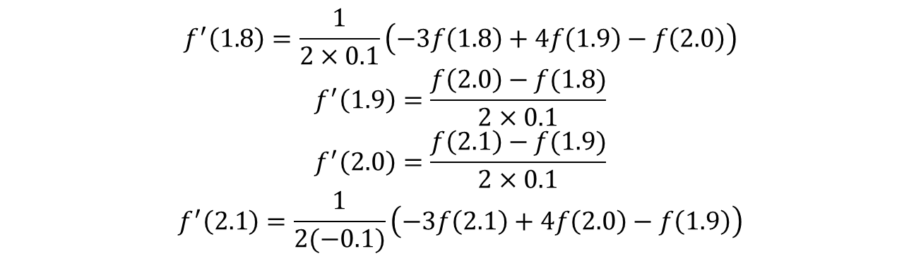
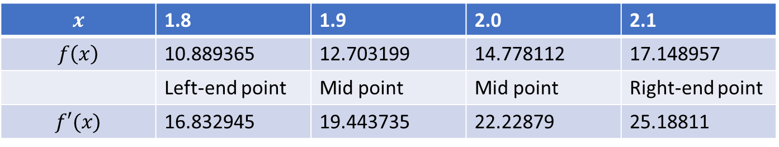
Example – 举个栗子
$$x$$ | 1.8 | 1.9 | 2.0 | 2.1
$$f\left(x\right)$$ | 10.889365 | 12.703199 | 14.778112 | 17.148957
 | Left-end point | Mid point | Mid point | Right-end point
$$f′(x)$$ | 16.832945 | 19.443735 | 22.22879 | 25.18811
$$f^{′}\left(1.8\right)=\frac{1}{2×0.1}\left(−3f\left(1.8\right)+4f\left(1.9\right)−f\left(2.0\right)\right)$$
$$f^{′}\left(1.9\right)=\frac{f\left(2.0\right)−f(1.8)}{2×0.1}$$
$$f^{′}\left(2.0\right)=\frac{f\left(2.1\right)−f(1.9)}{2×0.1}$$
$$f^{′}\left(2.1\right)=\frac{1}{2(−0.1)}\left(−3f\left(2.1\right)+4f\left(2.0\right)−f\left(1.9\right)\right)$$

Slide 6
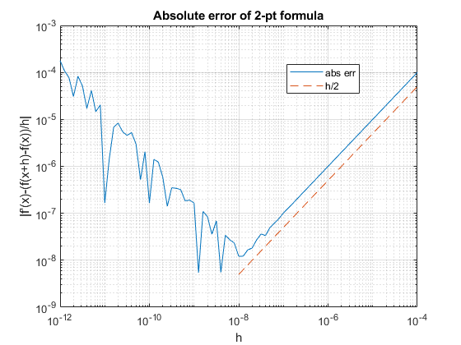

Round-off error instability
Suppose there are some cancellation error at the numerator.
$$f\left(x+h\right)−f\left(x\right)=\overline{f}\left(x+h\right)−\overline{f}\left(x\right)+e$$
Then, we have
$$f^{′}\left(x\right)=\frac{\overline{f}\left(x+h\right)−\overline{f}\left(x\right)+e }{h}+\frac{h}{2}f′′(ξ)$$
Assume $f′′$ is bounded, that is ${|f}^{′′}|<M$. Then,
$$\left|f^{′}\left(x\right)−\frac{\overline{f}\left(x+h\right)−\overline{f}\left(x\right) }{h}\right|≤\frac{e}{h}+\frac{h}{2}M$$
As $h→0$, the round-off error $e$ was amplified by $h$ and dominates.

Slide 7
Conclusion – 总结
2-pt formula
3-pt formula
Derivative suffers round-off error instability

